Slide 1
Employee Data Analysis using Excel
STUDENT NAME: Rithika.R
REGISTER NO: 422200252
DEPARTMENT: B.com ism
COLLEGE: Annai Violet arts and science college

Slide 2
Employee Performance Analysis using Excel
Excel can be used to analyze employee performance in a number of ways, including:
Performance review templates
Excel templates are a common method for performance reviews and can be customized to a company's needs. They can be used to track and compare employee performance over time, by department, category, month, or employee.

Slide 3


AGENDA
Problem Statement
Project Overview
End Users
Our Solution and Proposition
Dataset Description
Modelling Approach
Results and Discussion
Conclusion
3/21/2024 Annual Review

Slide 4

PROBLEM STATEMENT
problem statement is a clear and concise description of the problem or issue a team aims to address in a project. A problem statement identifies a problem's current state, desired future state, and the gaps that lie between the two.

Slide 5

PROJECT OVERVIEW
A project overview is a detailed description of a project's goals and objectives, the steps to achieve these goals, and the expected outcomes. In addition, a project overview enables you to outline the project schedule, budget, necessary resources, and status.

Slide 6

WHO ARE THE END USERS?
Management and executes
Employees
Team leader

Slide 7

OUR SOLUTION AND ITS VALUE PROPOSITION
A value proposition is a statement that explains the benefits of a product or service and why a customer should choose it over a competitor's. It's a key part of a company's marketing strategy and should be clear, concise, and easy to understand

Slide 8
Dataset Description
A dataset is a structured collection of data that is organized and stored for processing or analysis. Datasets can be made up of many different types of data, including: Numerical values, Text, Images, Audio recordings, and Basic descriptions of objects.
Datasets can be used for many purposes, including: Training and testing machine learning models, Data visualization, Research, and Statistical analysis.

Slide 9

THE "WOW" IN OUR SOLUTION
There are multiple matches for "the wow in our solution", including a Way of Working (WoW) approach, a live video support solution, and a design thinking concept:
Way of Working (WoW)
A business approach that promotes a culture of continuous improvement by focusing on collaboration, open communication, and problem-solving. WoW can help businesses streamline operations, reduce waste, and increase productivity.
3/21/2024 Annual Review
9

Slide 10
MODELLING
Modeling involves making a representation of something. Creating a tiny, functioning volcano is an example of modeling. Teachers use modeling when they have a class election that represents a larger one, like a presidential election. Modeling is anything that represents something else, usually on a smaller scale.
10

Slide 11
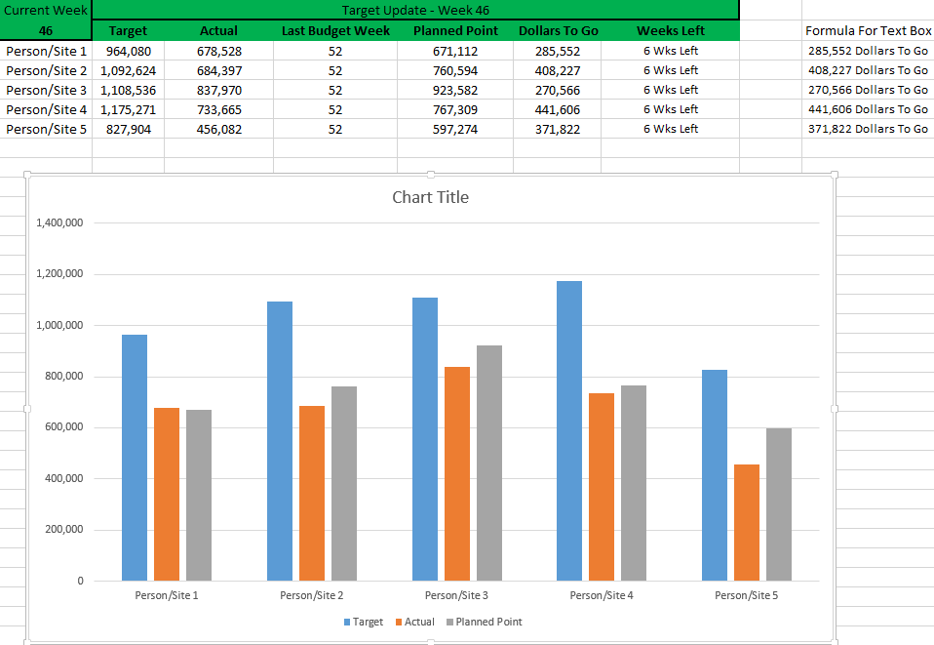
RESULTS
11

Slide 12
conclusion
Conclusion. This article highlights Excel's remarkable versatility and utility as a project management tool. From its familiar interface and cost-effectiveness to its advanced data analysis capabilities and robust reporting features, Excel stands out as a comprehensive solution for various project management needs

